Slide 2

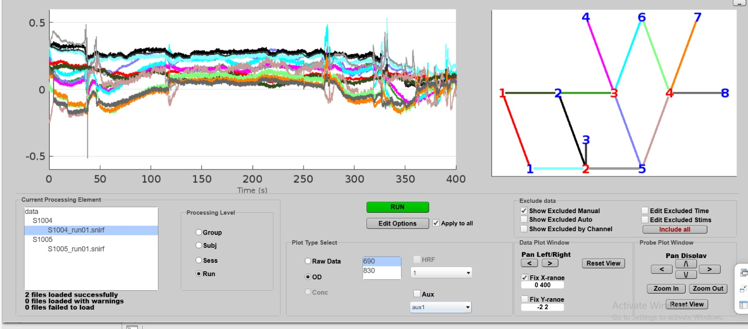
Let’s Work on the Data
NeuroLight Combines Theory & Hands-on
Notes:
55

Slide 3
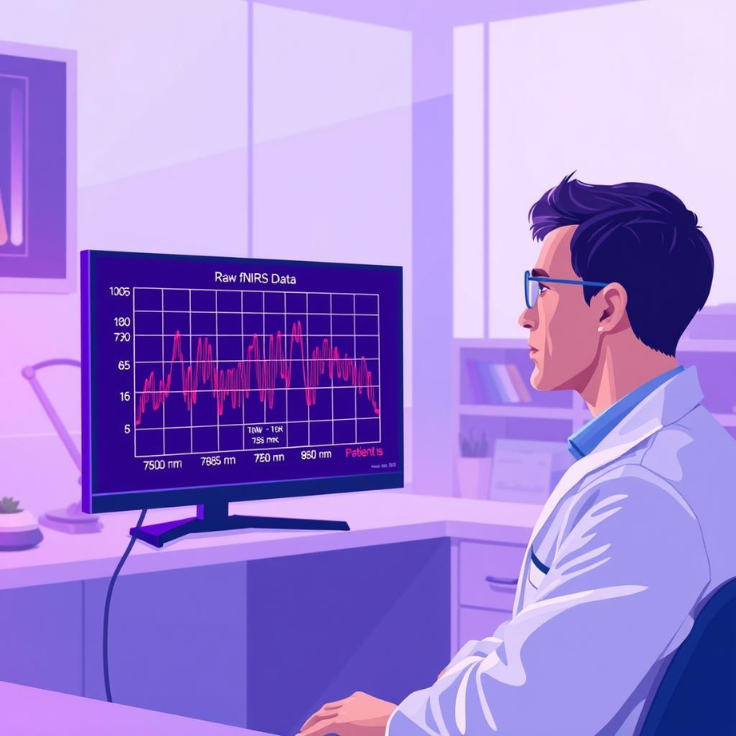
Data Exploration
Notes:
55

Slide 4
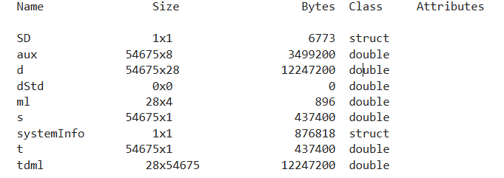
Data Exploration
Step 1: Load the real data & understand the file
Variable | Description
d | Raw light intensity (channels × time)
t | Time vector (in seconds)
s | Stimulus vector (1 = event on)
aux | Auxiliary signals (e.g., accelerometer)
ml | Measurement list (channel & wavelength mapping)
SD | Source-detector geometry (layout, wavelengths)
tdml | Transposed version of d (not necessary)
systemInfo | Metadata about acquisition device
Command
>> sub_1= matfile('S1001_run01.nirs’)
> whos(sub_1)
Result
Notes:
58

Slide 5
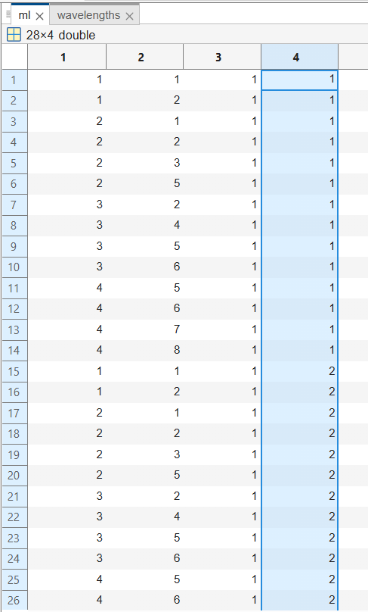
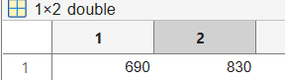
Data Exploration
Step 2: Discover optodes placements and wavelengths used
Command
Column | Meaning
1 | Source index (source optode number)
2 | Detector index (detector optode number)
3 | Active flag — typically 1 = active
4 | Wavelength index — usually 1 or 2 (e.g., 690 nm and 830 nm)
>> SD= sub_1.SD;
wavelengths= SD.Lambda;
>>ml= sub_1.ml;
Result
Notes:
58

Slide 6
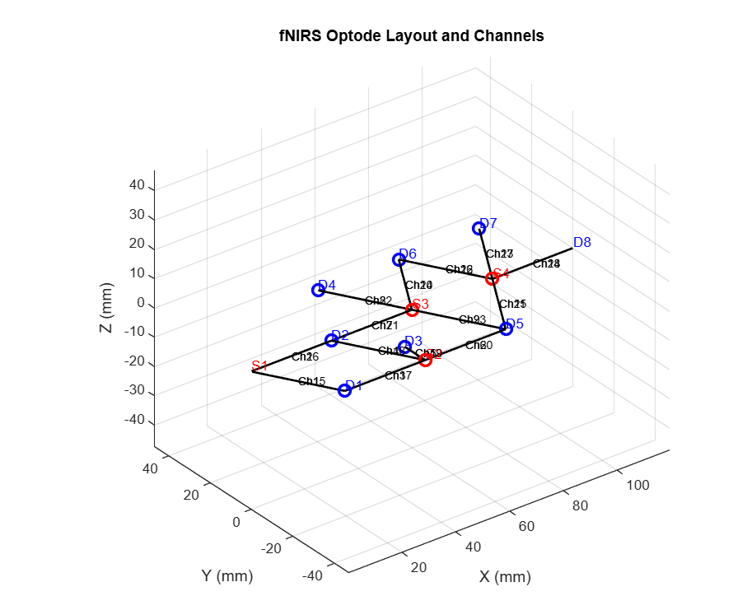
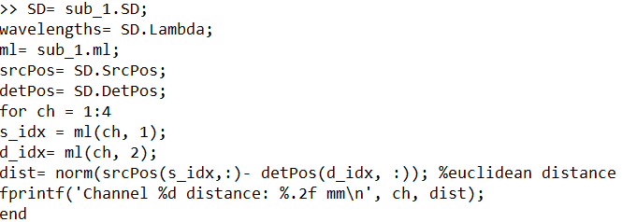
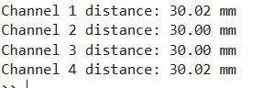
Data Exploration
Step 3: Get source-detector distance Visualize optodes
Command
Result
Notes:
58

Slide 7
Preprocessing in fNIRS
Notes:
55

Slide 8

Disclaimer!!
We assume that you have background knowledge from DSP and computer vision courses
Notes:
55

Slide 9
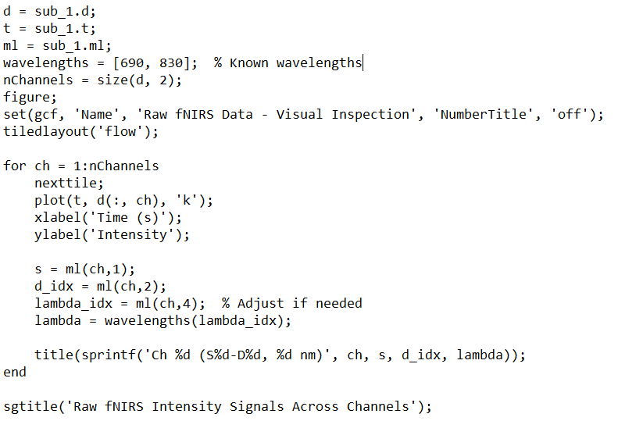
Preprocessing Steps
Step 1: A) Visual Inspection on subject level
Command
Notes:
56

Slide 10
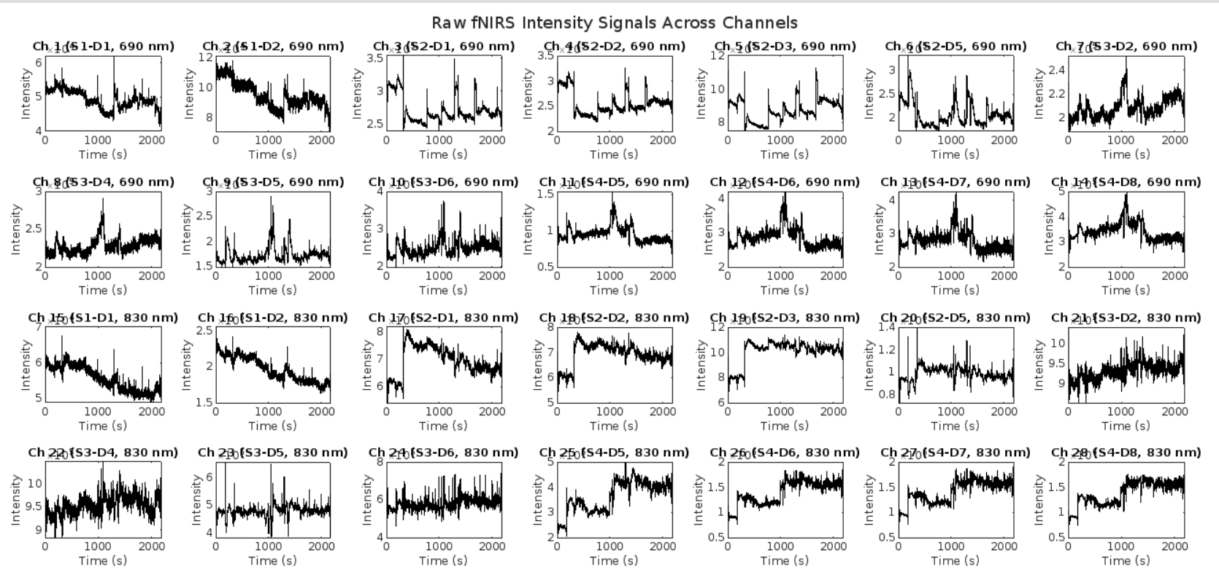
Preprocessing Steps
Step 1: A) Visual Inspection on subject level
Notes:
56

Slide 11
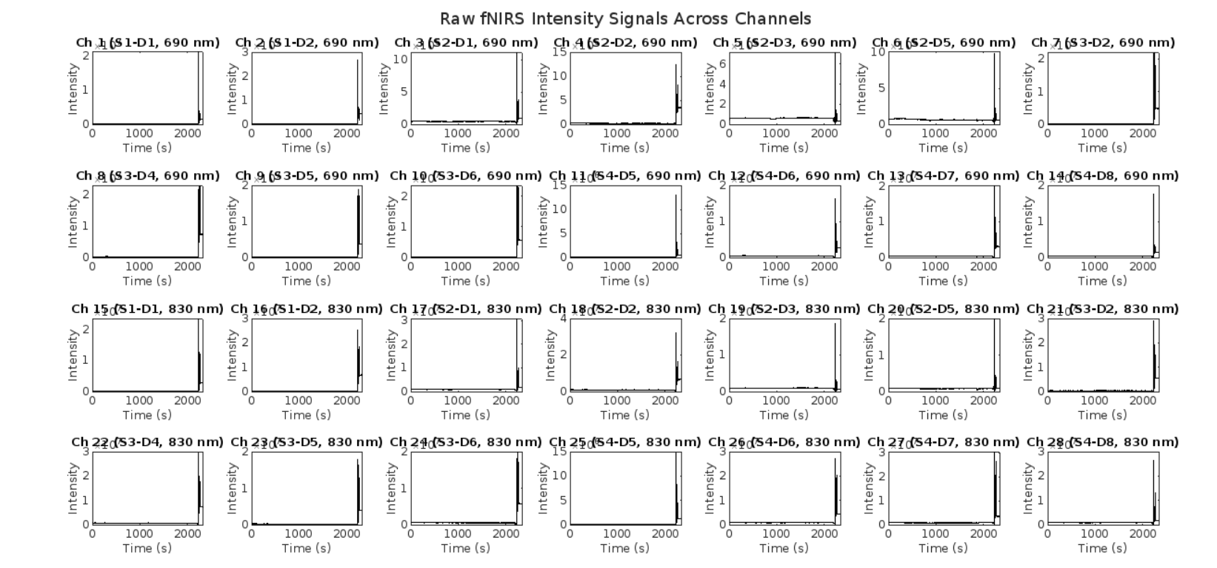
Preprocessing Steps
Step 1: A) Visual Inspection on subject level
Notes:
56

Slide 12
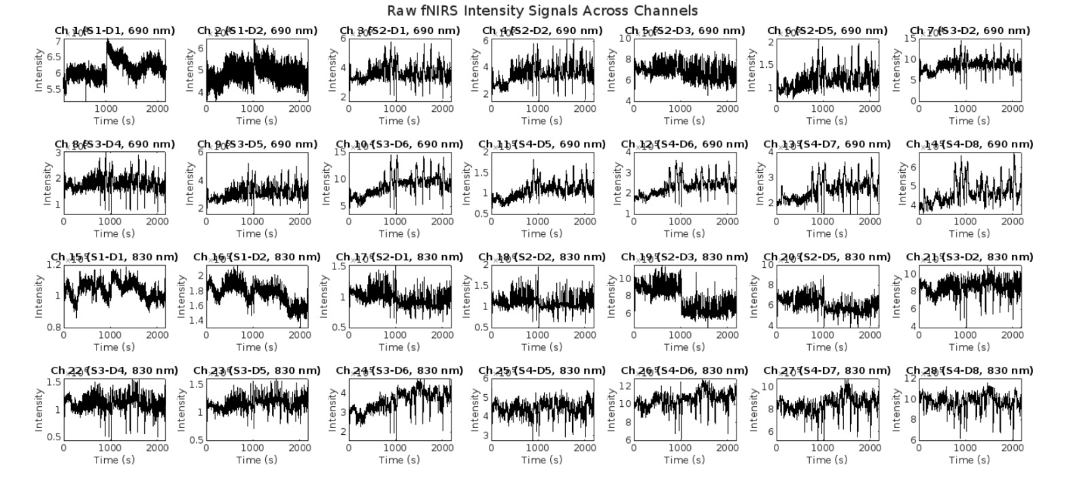
Preprocessing Steps
Step 1: B) Visual Inspection on channel level
Notes:
56

Slide 13
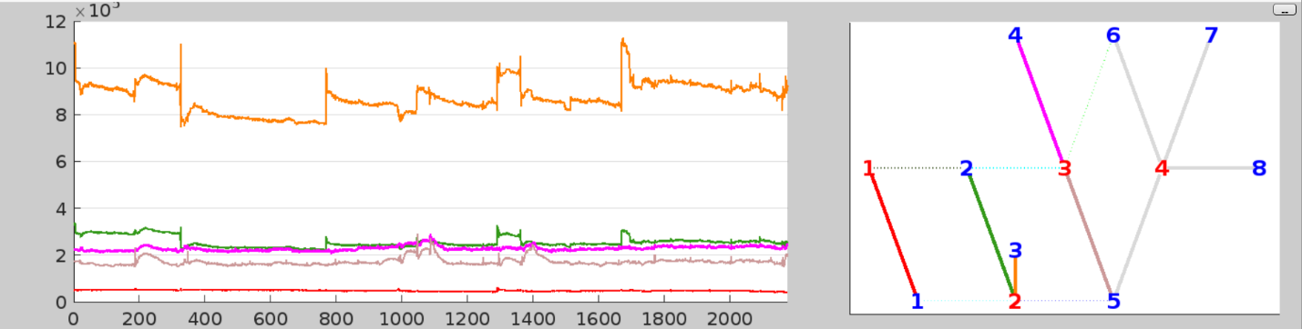
Preprocessing Steps
Step 1: C) Focus on specific channels for clarification
First Five Channels
Optode Mapping
Notes:
58

Slide 14
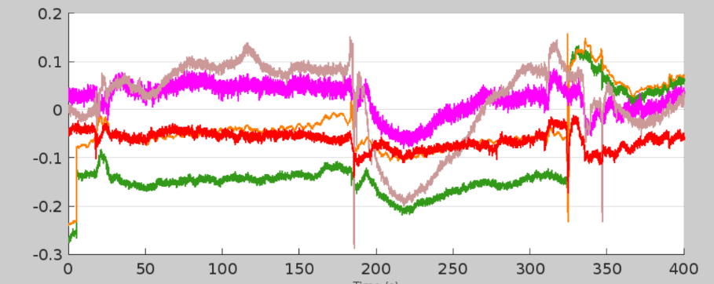
Preprocessing Steps
Step 2: Convert to optical density & visualize again
Command
Result
>> dod = hmrIntensity2OD(d);
Notes:
56

Slide 15
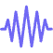
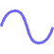


Preprocessing Steps
Step 3: Motion Correction
Common Correction Techniques:
Wavelet Filtering
Spline Interpolation
Principal Component Analysis (PCA)
Kalman Filtering
Notes:
60

Slide 16
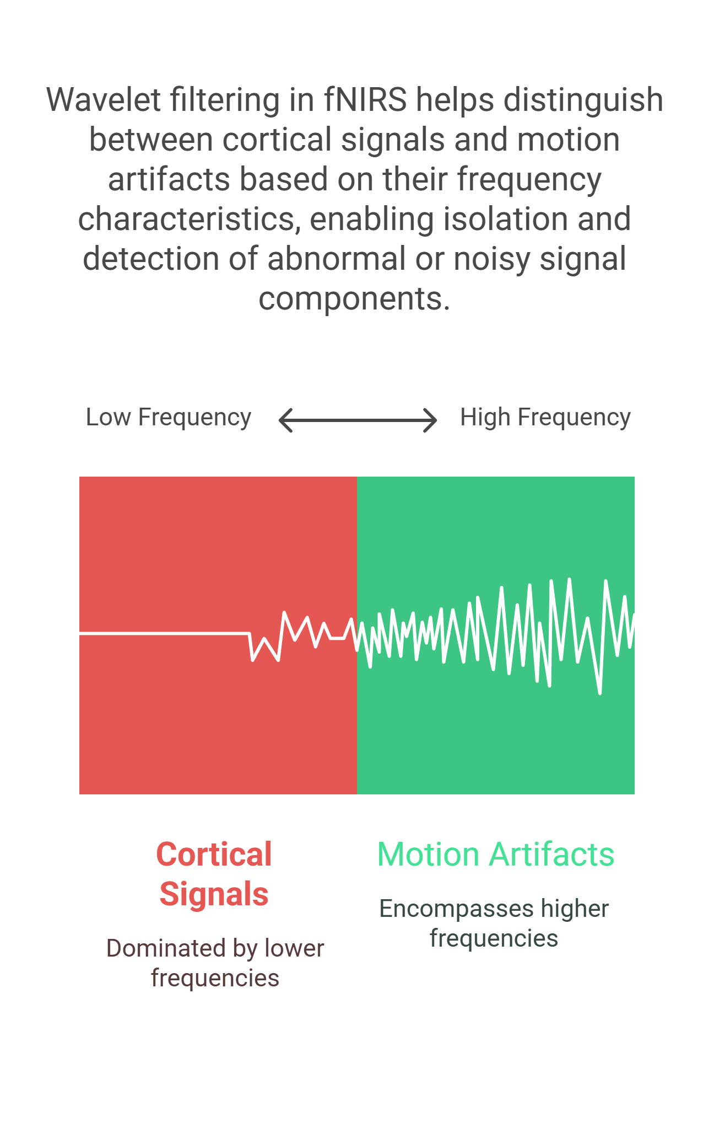
Wavelet Transform Overview
Starts with a mother wavelet
Generates daughter wavelets via scaling & translation
Decomposes signal into wavelet coefficients:
Show how well the wavelet matches signal parts at various time-frequency scales
Output:
Coefficients reflect structure in the signal
Outliers often = motion artifacts
Notes:
62

Slide 17
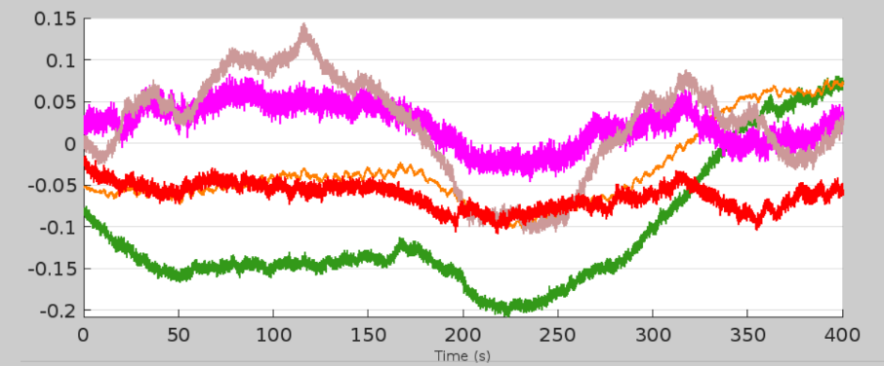
Preprocessing Steps
Step 3: Wavelet Filtering – Motion Correction
Command
[d_wavelet, ~] = hmrMotionCorrectWavelet(data.d, data.t, iqr_thresh);
Result
Before
After
Notes:
58

Slide 18
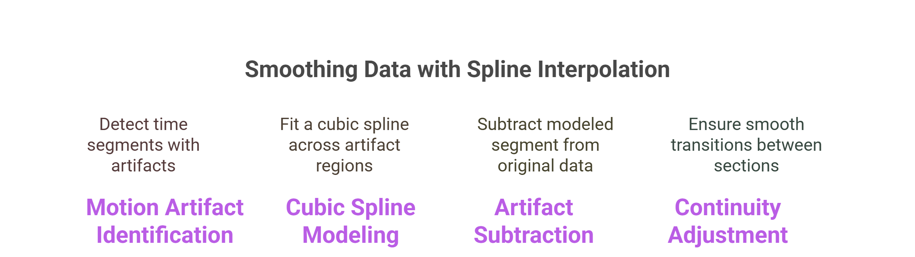
Spline Interpolation
Notes:
69

Slide 19
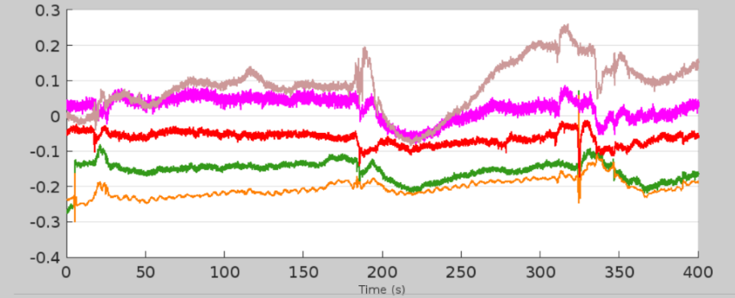
Preprocessing Steps
Step 3: Spline Interpolation – Motion Correction
Command
data_corrected=hmrR_MotionCorrectSpline(p)
Result
Before
After
Notes:
58

Slide 20
Preprocessing Steps
Step 4: Filtering Techniques
Frequency Based Filters
PCA filters
Low pass, band pass, and high pass filters to remove unwanted frequency components.
Decompose signal into principal components and remove highest variance component.
Notes:
76

Slide 21

Step 4: Frequency Based Filters -- Filtering Techniques
Low Pass
High Pass
Band-pass
Key Notes:
“One size fits all" doesn't apply.
Limitations: Noise frequency range overlap with signal. High pass can introduce ripples. Filters attenuate unwanted ranges but don't completely remove them.
Notes:
77

Slide 22
Preprocessing Steps
Band-Pass filter
Command
hpf = 0.01; % high-pass cutoff (Hz) lpf = 0.5; % low-pass cutoff (Hz)
[dod_filt, ~] = hmrBandpassFilt(dod, t, SD, hpf, lpf);
Result
Before
After
Notes:
58

Slide 23
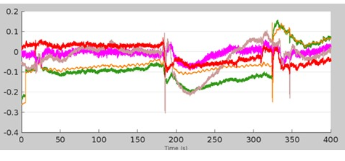
Preprocessing Steps
Step 4: PCA Filter – Filtering Techniques
Command
>> PCAFilter(nSV) %% Number of principal components to remove
Result
Before
After
Notes:
58

Slide 24
Preprocessing Steps
Step 5: Baseline correction:
Method | When to Use | Homer Function
Bandpass Filter | Always | hmrBandpassFilt
Baseline Subtraction | Block design avg | hmrBlockAvg
GLM with Drift Correction | GLM-based studies | hmrDeconvHRF_DriftSS
Notes:
79

Slide 25
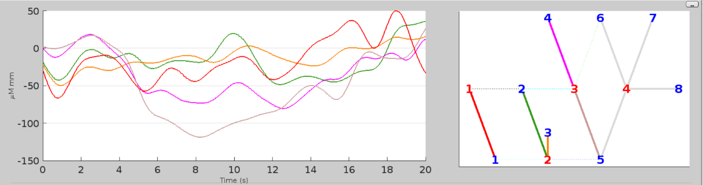
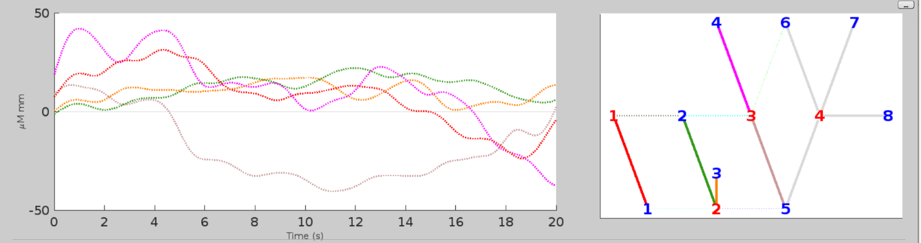
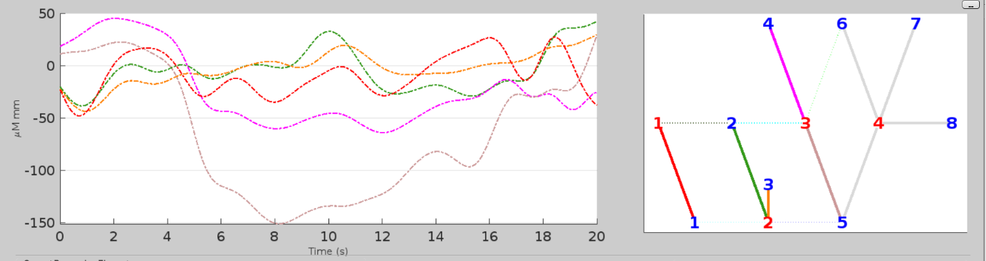
Preprocessing Steps
Command
Step 6: Modified Beer lambert law
dc = hmrOD2Conc(dod, SD, ppf); % dc = HbO, HbR, HbT concentrations
HBO
HBR
HBT
Notes:
79

Slide 26
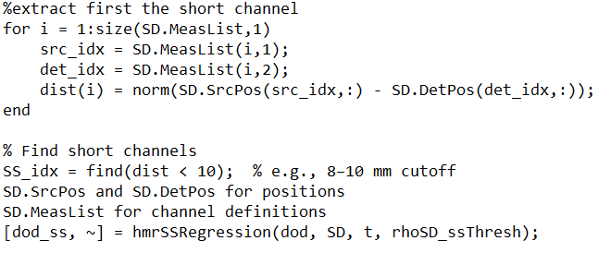
Preprocessing cont.
Step 7: Short Separation Channel (Recommended)
Command
To be used in GLM to regress out the component of the LS signal that correlates with the SS signal
Notes:
81

Slide 27
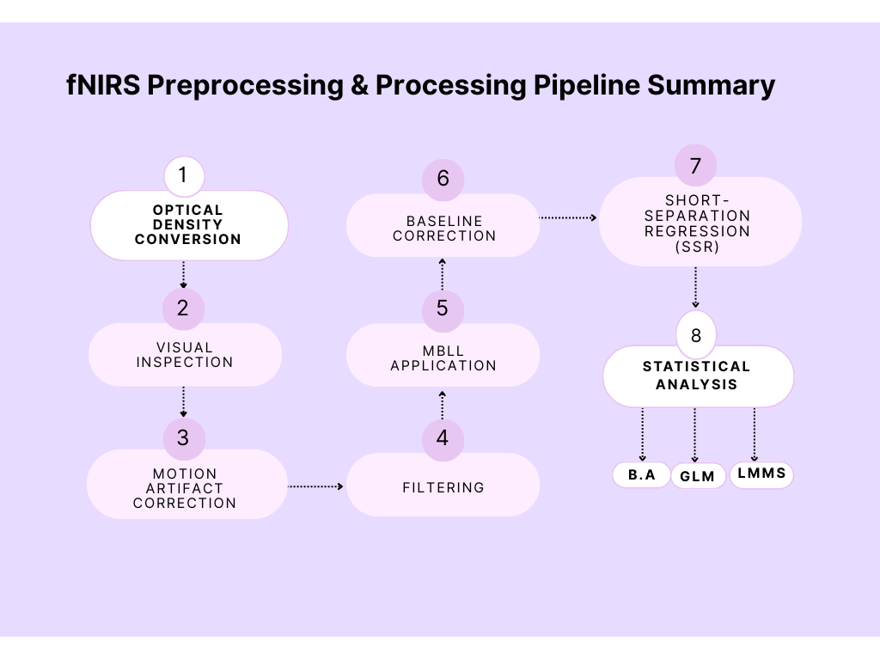

Slide 28

Preprocessing Final Note
The preprocessing steps outlined here are not always followed in a strict order, nor are all steps necessarily applied.
The specific sequence and choice of preprocessing techniques depend on the quality of the raw data and the objectives of the study.
Notes:
81

Slide 29
Our Study Pipeline
Motion Artifacts Identification?
Raw Signal Intensity
PCA for Noise Reduction
De-mean & Convert
Band-Pass Filter 0.016-0.5 HZ
Eliminate Trials
Band-Pass Filter 0.016-0.2 HZ
Apply Modified BLL

Slide 30

fNIRS Statistical Analysis
Now, you have the cleaned data. Next Step is Analysis. Goal: Answering the research question, like
1- Which areas were activated?
2- Are there differences between conditions or groups ?
Notes:
82

Slide 31
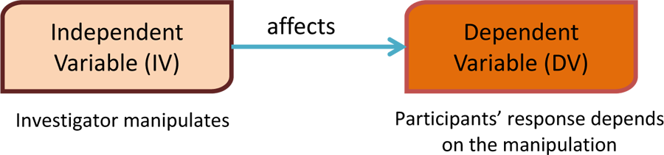
Let's be clear on some statistical concepts:
Any statistical model aims to describe how the dependent variable is influenced by the effects of the independent variables.
Notes:
83

Slide 32
Independent variable can be:
Fixed
Random
The values are fixed, and they represent the whole population of values in which we’re interested in
You don’t interpret their exact value.
You model their variance to avoid biasing your fixed effects.
These subject-specific values are treated distribution (usually normal).
Notes:
83

Slide 33

How this applies to fNIRs?
Just keep this in Mind!
Dependent Variable
Time series change in HbO or HbR.
Independent Variable
(Regressor)
Fixed
Stimulus Timing
Random
Subject-specific deviations from that average — e.g., some subjects have larger or smaller HbO changes than the group mean
Notes:
83

Slide 34

Statistical Analysis Methods
Notes:
28

Slide 35
Block Average
Notes:
39

Slide 36
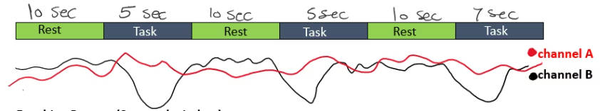
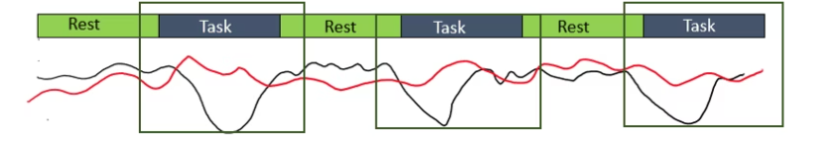
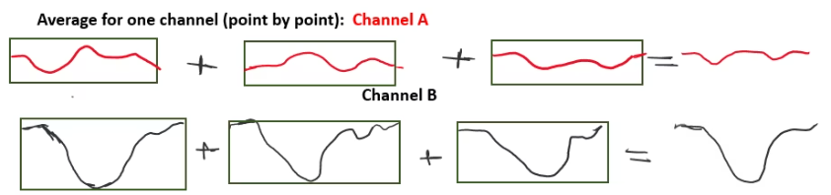
1- Experimental Settings (Two Channels, boxcar/ time regressor)
2- Epoching/ Segment Data
3- Average all blocks for that channel (point-by-point across time) to get average HRF
Notes:
85

Slide 37
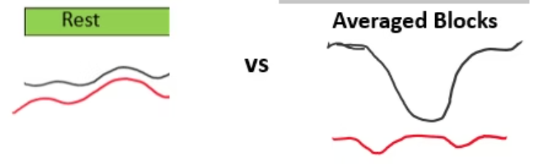
4- Comparison with rest state signal or across channels
Notes:
85

Slide 38
Comments on Block Average
It's a descriptive analysis technique not a statistical model on itself. However, you can follow it with statistical tests (e.g., t-tests) to assess whether the observed response differs significantly from baseline or across conditions.
When to Use Block Averaging
Your design is simple and block-based
You want a quick look at response shapes.
For visual inspection before applying GLM or LMM.
Limitations
Reduces temporal resolution by collapsing time series into an average.
Cannot model noise, confounding variables, or multiple regressors.
Notes:
84

Slide 39
GLMs
Notes:
39

Slide 40
Generalized Linear Model
GLM Assumptions:
Considerations for Assumptions:
1- Task responses are non-stochastic (non-random) and are the same across trials of the same task.
1- GLM accounts for fixed variables only. If this is violated, results vary a lot
2- Do pre-whitening to convert correlated "color" noise to uncorrelated noise. Use Autoregressive Model to do this conversion.
2- Noise is independently and identically distributed (White Noise)
3- Do multicollinearity step. Variance Inflation Factor (VIF) can be computed to detect multicollinearity.
3. Predictors are not linear derivations of each other
Notes:
86

Slide 41
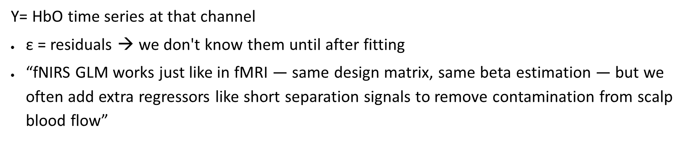
Generalized Linear Model
$$\text{Y}\text{= }\text{X} \text{β} \text{+} \text{ε}$$
X = design matrix with fixed effect regressors:
Task A (stimulus function convolved with HRF)
Task B (stimulus function convolved with HRF)
SS regressor (the signal from a short-separation channel)
Y= HbO time series at that channel
$\text{ε}$ = residuals → we don't know them until after fitting
“fNIRS GLM works just like in fMRI — same design matrix, same beta estimation — but we often add extra regressors like short separation signals to remove contamination from scalp blood flow”
Notes:
86

Slide 42

Steps of GLM
1
$$\text{Y}\text{= }\text{X} \text{β} \text{+} \text{ε}$$
Pre-whitening
Pre-whitening = Removing autocorrelation
Transformation
*
Autoregressive Model
Problems of Autocorrelation: False positives
Making sure the noise is flat, not bumpy (correlated), so you don’t mistake a bump for a signal.
$$\text{A}\text{Y}\text{= }\text{A}\text{X} \text{β} \text{+} \text{A}\text{ε}$$
So instead of looking at the data in its original coordinate system, you rotate your view (via the AR-based transformation matrix)
Notes:
87

Slide 43
Steps of GLM
$$\text{Y}\text{= }\text{X} \text{β} \text{+} \text{ε}$$
2
Design Matrix & Response
X Y
Time (s) | Task A | Task B | SS regressor
0 | 0 | 0 | 0.2
5 | 0.8 | 0 | 0.3
10 | 0.6 | 0 | 0.25
15 | 0 | 0.9 | 0.3
20 | 0 | 0.7 | 0.2
... | ... | ... | ...
​0.1
0.5
0.4
0.6
0.5
Notes:
87

Slide 44
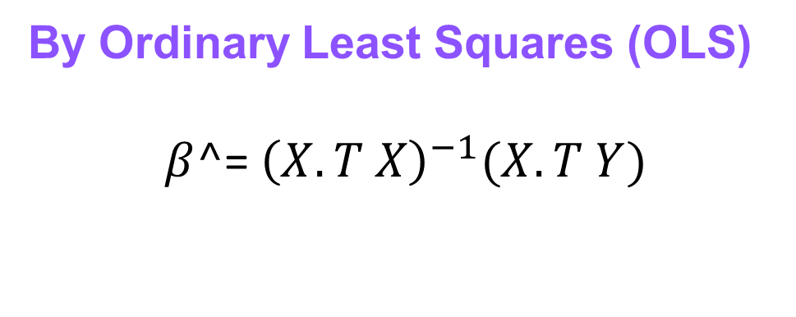
Steps of GLM
$$\text{Y}\text{= }\text{X} \text{β} \text{+} \text{ε}$$
3
Solve
By Ordinary Least Squares (OLS)
$β^$​= ${\left(X.T X\right)}^{−1}(X.T Y)$
Notes:
87

Slide 45
LMMs
Notes:
39

Slide 46
Linear Mixed Models
It extends GLM by incorporating the random variables.
LMM allows random slopes and intercepts per subject, improving inference and generalization
This framework allows researchers to draw population-level inferences while maintaining sensitivity to individual differences.
$$\text{Y}\text{= }\text{X} \text{β}\text{ + }∝Z\text{+} \text{ε}$$
X: Fixed Effects
Z: Random Effects
Notes:
88

Slide 47
Linear Mixed Models
Z
You still get overall fixed effects for Task A, Task B, SS regressor (as in GLM).
Time (s) | Subj1 Intercept | Subj1 Task A | Subj2 Intercept | Subj2 Task A
0 | 1 | 0 | 0 | 0
5 | 1 | 0.8 | 0 | 0
10 | 1 | 0.6 | 0 | 0
15 | 0 | 0 | 1 | 0
20 | 0 | 0 | 1 | 0
But you also estimate how much subjects vary — e.g., whether Subject 1 responds more or less strongly to Task A than average.
This increases statistical power and generalizability, and avoids treating all inter-subject variability as noise.
Notes:
88

Slide 49
End of the Neuro-Light Lab fNIRS Analysis Section
Scripts

